Slide 1

ENHANCING MRI IMAGES USING FAST RESOLUTION CONVOLUTIONAL NEURAL NETWORK Presented by KARTHIKEYAN K (22CSEG15) Under the Guidance of Dr .J. SATHEESH KUMAR, M.C.A., Ph.D., Professor
DEPARTMENT OF COMPUTER APPLICATION BHARATHIAR UNIVERSITY COIMBATORE

Slide 2
AGENDA
OBJECTIVE
FSRCNN
WORKFLOW
PREPROCESSING AND GENERATING PAIRS
TRAINING
ENHANCING IMAGES WITH VARIOUS ACTIVATIONS
EVALUATIONS
CONCLUSION

Slide 3
OBJECTIVE
To enhancing the quality of MRI (Magnetic Resonance Imaging) images is to improve the clarity, resolution, and diagnostic value of the images. MRI is a powerful medical imaging technique that uses strong magnetic fields and radio waves to generate detailed images of the internal structures of the body. However, the raw images obtained from MRI scanners may sometimes suffer from various artifacts and imperfections that can reduce their overall quality.
Enhancing the quality of MRI images serves several important purposes:
Improved Diagnosis
Increased Sensitivity
Better Visualization

Slide 4
INTRODUCTION TO FAST SUPER RESOLUTION CONVOLUTIONAL NEURAL NETWORK
FSRCNN, which stands for Fast Super-Resolution Convolutional Neural Network, is a deep learning model designed for image super-resolution. Image super-resolution is the process of enhancing the resolution of an image, making it appear sharper and more detailed. This can be particularly useful in applications where higher resolution images are required, such as in medical imaging, satellite imagery, or improving the quality of low-resolution Images.
While FSRCNN is not specifically designed for MRI image enhancement, it can be adapted for such purposes by training the model on a dataset of MRI images.

Slide 5
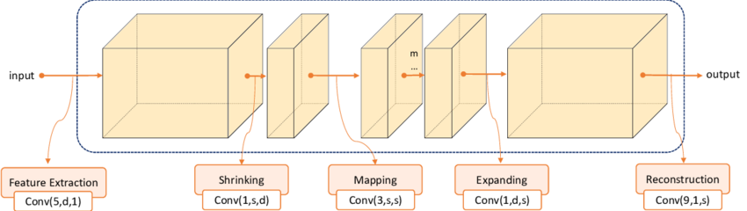
FAST SUPER RESOLUTION CONVOLUTIONAL NEURAL NETWORK

Slide 6
FAST SUPER RESOLUTION CONVOLUTIONAL NEURAL NETWORK
Feature extraction involves capturing relevant information or characteristics (features) from an image while discarding less important details. These features may include edges, textures, or patterns.
Shrinking in the context of image processing, typically refers to a process where the size of the image or certain components of the image is reduced.
The mapping step involves learning a mapping function that transforms the low-resolution features into high-resolution features. This is the core of the super-resolution task and is usually implemented using convolutional layers in a neural network. The network learns to map the low-resolution features to corresponding high-resolution features.
After mapping, the high-resolution features are expanded or upsampled to match the desired output resolution. Upsampling layers, such as transposed convolutions or interpolation methods, are commonly used for this purpose.

Slide 7
WORKFLOW
Data collection
Model training
Data Transformations
Evaluation
Data Preprocessing
This workflow provides a general guideline for using FSRCNN for super-resolution tasks.

Slide 8
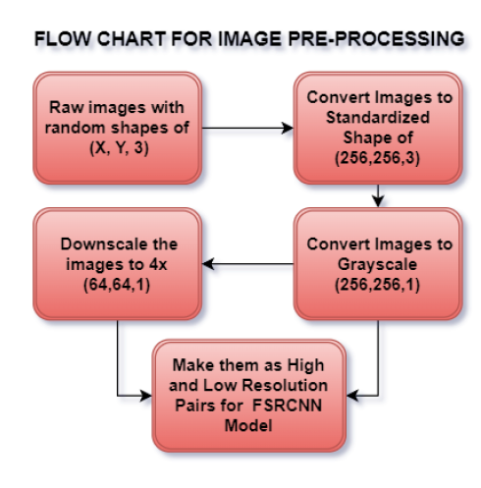
PREPROCESSING AND GENERATING PAIRS
The preparation of data for the FSRCNN model involves transforming raw images with random shapes (x, y, 3) into a standardized size of (256, 256, 3).
These images are then converted to grayscale, resulting in (256, 256, 1) dimensions. To facilitate training, the grayscale images are downscaled by a factor of 4 to (64, 64, 1), creating low-resolution pairs.
The final dataset comprises these low-resolution images paired with their original high-resolution counterparts, forming the basis for training the FSRCNN model.
This model specializes in single-image super-resolution, learning to generate high-resolution reconstructions from the provided low-resolution inputs.

Slide 9
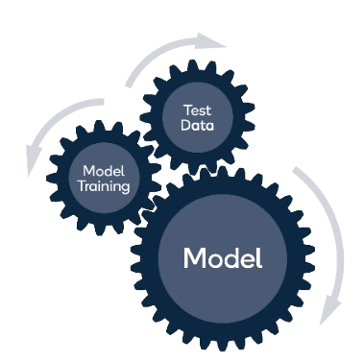
TRAINING
The FSRCNN model enhances image resolution through a Convolutional Neural Network. Key elements like Conv2D layers, activation functions (e.g., ReLU, PReLU), and padding are used. Training involves optimizing with Adam, using a batch size and epochs, and employing data augmentation for better generalization.
The model is compiled with mean squared error as the loss function, suitable for regression tasks. Data augmentation, which artificially expands the training dataset, is implemented for improved model performance.
During training, two callbacks are utilized: ReduceLROnPlateau adjusts learning rates based on loss, and ModelCheckpoint saves the best model weights. The process ensures efficient learning and prevents overfitting.
In summary, FSRCNN employs a straightforward architecture with practical training strategies to enhance image resolution effectively.

Slide 10
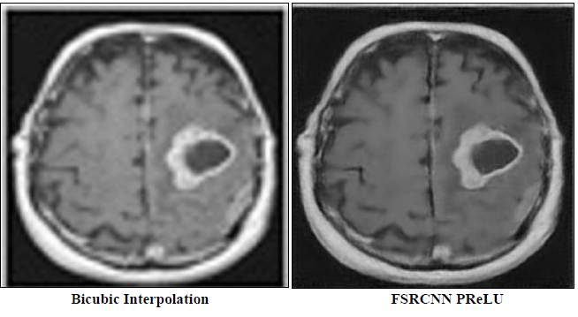
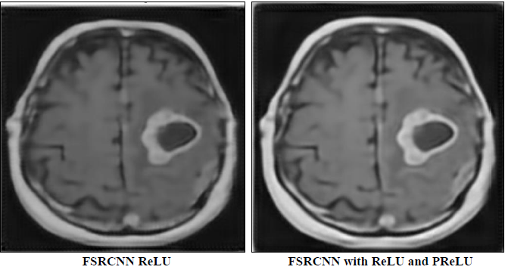
ENHANCING IMAGES WITH VARIOUS ACTIVATIONS

Slide 11

EVALUATIONS
PSNR (Peak Signal-to-Noise Ratio), SSIM (Structural Similarity Index), and MSE (Mean Squared Error) are metrics commonly used in image processing to assess the quality of images or the performance of image processing algorithms.
Peak Signal-to-Noise Ratio (PSNR): PSNR is like a quality check for images. It tells us how much an image has changed compared to the original, focusing on things like blurriness or added "noise." When PSNR values are higher, it means the image looks more like the original.
Structural Similarity Index (SSIM): SSIM helps us see how similar two images are in terms of their overall look. It considers factors like brightness and contrast. If SSIM values are closer to 1, it means the images are very similar. It's like a buddy system for images, checking if they still look alike.
Mean Squared Error (MSE): MSE measures the average difference between the pixels of two images. Lower MSE values mean the images are more alike. It's like checking how much each pixel has changed on average. So, when MSE is low, it's a sign that the images are pretty close to each other.

Slide 12
EVALUATIONS

Slide 13
CONCLUSION
The evaluations of different FSRCNN configurations consistently show relatively high Mean Squared Error (MSE) values, indicating notable average discrepancies. However, the Peak Signal-to-Noise Ratio (PSNR) values consistently suggest decent to good image quality across the models. Notably, the Structural Similarity Index (SSIM) values are relatively high, indicating well-preserved structural information in the reconstructed images across the different configurations

Slide 14
CONCLUSION
Objective: The FSRCNN project aimed to enhance MRI image resolution using a convolutional neural network (CNN) trained on 500 augmented images.
Variants: The FSRCNN with ReLU and PReLU variants were implemented, with the latter demonstrating slightly better performance in terms of PSNR and SSIM, as well as better image quality and preservation of structural information according to viewer perspectives.
Performance: While the project showed promise, limitations were observed due to the relatively small size of the training dataset (500 images) and challenges posed by low pixel size in input images (64x64x1) compared to higher resolution target images (256x256x1).
Constraints: The small dataset and low-resolution input images limited feature extraction and subsequent image reconstruction, impacting overall model performance.
Recommendations for Improvement: To address limitations, future efforts should focus on expanding the training dataset and considering larger input image sizes to capture more intricate features and nuances. Optimizing hyperparameters, such as learning rates, is also suggested to contribute to enhanced performance.

Slide 15


